Slide 1

FIFA 2022
Capstone Project III

Slide 2

Agenda
Introduction
Hypotheses
Data
Methods
Findings
Recommendations

Slide 3

FIFA and its players
International Federation of Association Football(FIFA) draws around 5 billion viewers every year;
World cup is the biggest single sport event every four years.
16710 soccer players registered with FIFA 2022
Huge disparity in wages among players(500 – 350,000 Euro per week)

Slide 4

There are two sets of hypotheses :
Hypotheses 1. the player’s skill of dribbling and capability of scoring are correlated; and the scoring and the wage they earn are also correlated.
Hypotheses 2. the player’s skill of dribbling, capability of scoring and the wage between South American and European have no significant difference.

Slide 5
The dataset contains 65 columns and 16,710 rows. The columns include personal details of each player, such as nationality, age, weight, height, as well as extensive information about their skills, performance, value, and wage.
Column name | Format example | Data type | After Cleaning
Dribbling | 83.0 | float | N/A
Finishing (proficiency of scoring) | 75.0 | float | N/A
Wage | €250K | object | 250000 (int)
Nationality | Brazil | object | N/A
Position | <span class="pos pos18">CAM | object | 18CAM(object)

Slide 6
Data filtering and selection:
FIFA2022
Attacking position
Players top 10 SA
Players top 10 EU
Notes:
Out of 22 World Cup tournaments, South American teams won 10 times, and European teams won 12 times.

Slide 7
Method: Pearson r and independent t tests
FIFA2022
Pearson r tests: dribbling vs score
Pearson r test: score vs wage
Attacking position
Players
top 10 SA
Players top 10 EU
T tests to compare
Dribbling
Score
Wage
between SA and EU

Slide 8
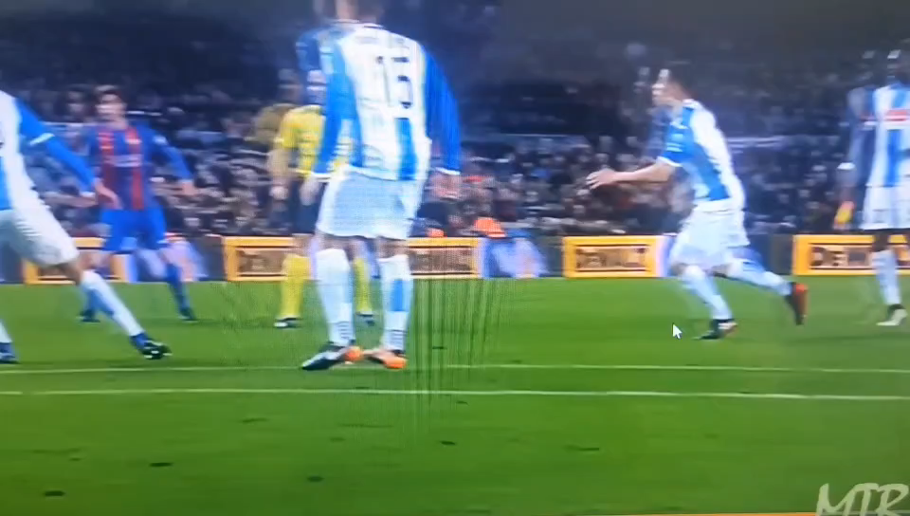
Dribbling: the skill to take on opponents one-on-one, utilizing close ball control, quick changes of direction, and tricks to bypass defenders.

Slide 9
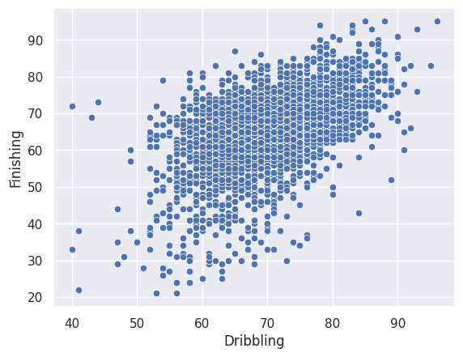
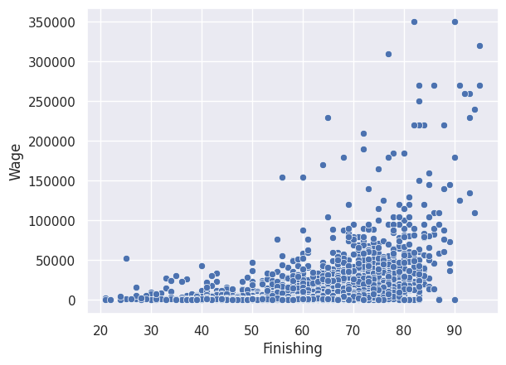
Findings – hypotheses 1.
There is a statistically significant linear relationship between dribbling and scoring, the relationship is positive, and the correlation is strong(with 0.52 correlation efficient)
There is a statistically significant linear relationship between scoring and wage. The relationship is positive, and the correlation is moderate (with 0.39 correlation efficient)

Slide 10
Findings – hypotheses 2
Players from top 10 SA
Players from top 10 EU
Brasil, Argentina, Uruguay, Colombia, Chile, Perú, Paraguay, Ecuador, Venezuela, Bolivia
Belgium, France, England, Spain, Germany, Portugal, Italy, Netherlands, Croatia, Switzerland
 | dribbling | score | wage
SA | 72.03 | 66.77 | €15336.22
EU | 70.16 | 64.77 | €19449.30
Difference on average | SA players dribbling 1.16 to -2.59 points higher | SA players scoring 0.87 to 2.88 points higher | EU players are paid €1251.03- €6975.13 more
Difference on average by percentage | 1.7%-3.7% | 1.3% -- 4.4% | 8.2%-45.5%

Slide 11

recommendations
Soccer athletes, coaches, and clubs can utilize these findings to focus on specific skills for improving overall performance and maximizing financial returns.
The findings will be valuable to soccer enthusiasts and fans.
There are more research to understand the big wage gap between South American and European players.

Slide 12
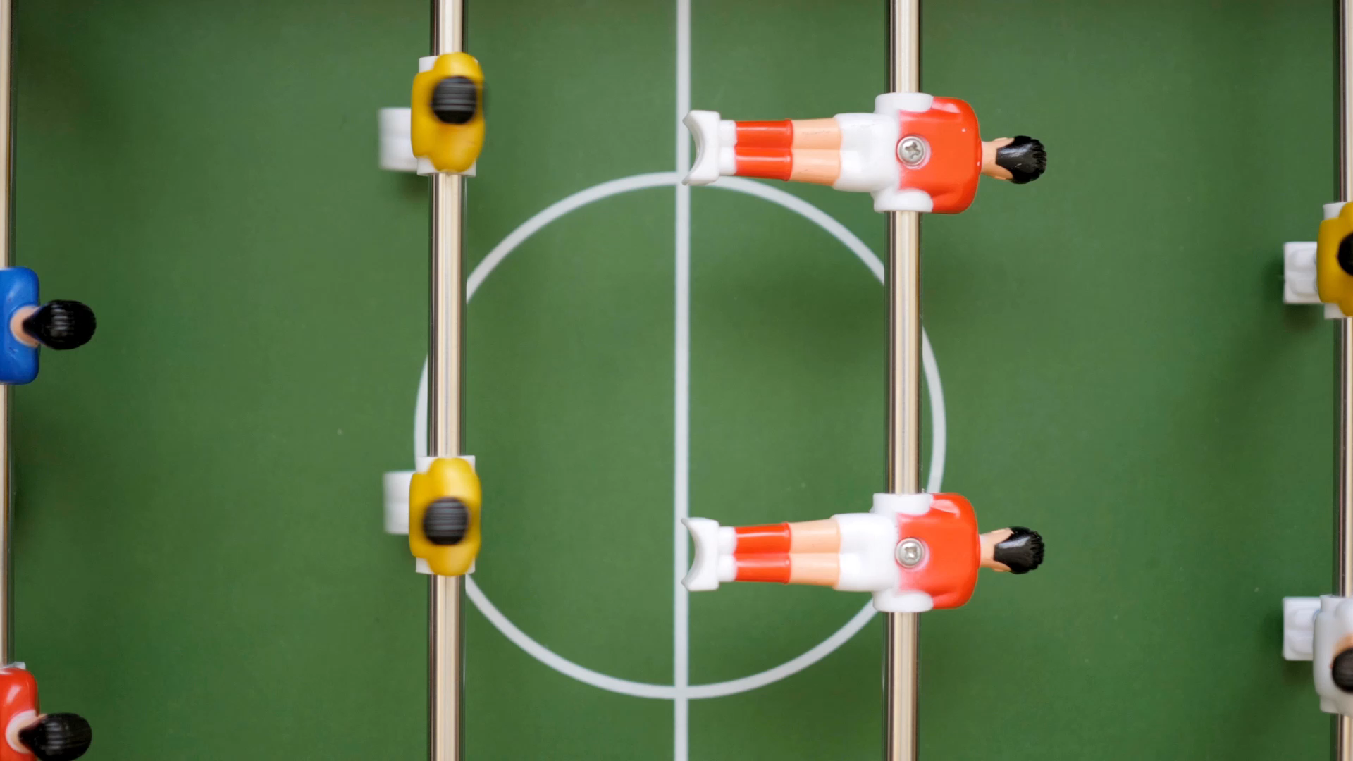
Thank you!

